Slide 1
Fooling and Protecting Deep learning models
Divyam Madaan
Twitter: @divyam3897
Github: @divyam3897

Slide 2

About me
Final year undergraduate
Deep Learning Researcher at FOR.ai
Working on Adversarial Training and Robustness

Slide 3



Machine learning reached state of the art on various tasks

Slide 4

Good models make mistakes

Slide 5
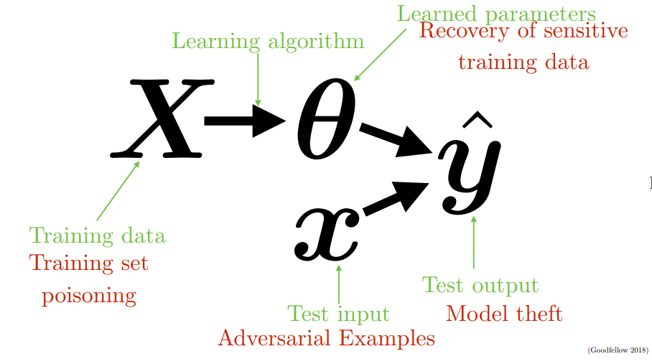
Attack on the machine learning pipeline

Slide 6
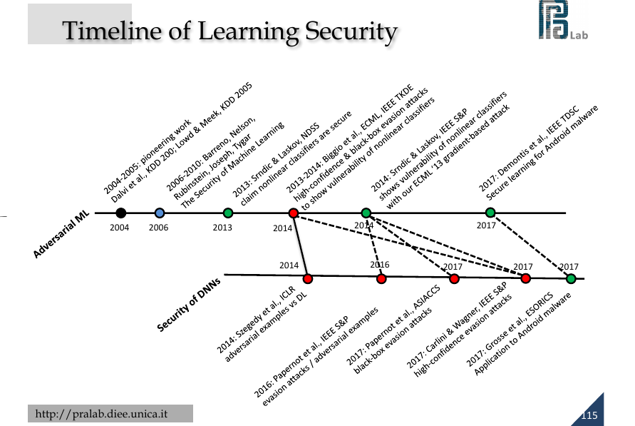

Slide 7
What this means for us?
Deep learning algorithms (Machine learning in general) are susceptible to attacks
Use with caution in critical deployments
Evaluate a model’s adversarial resilience - not just accuracy/precision/recall
Spend effort to make model robust to tempering

Slide 8
Defending the machines
Distillation (Train model 2x, feed first DNN output logits into second DNN input layer)
Train models with adversarial samples i.e ironing out imperfect knowledge learnt in the model)
Special regularization methods/loss functions (simulating adversarial content during training)

Slide 9
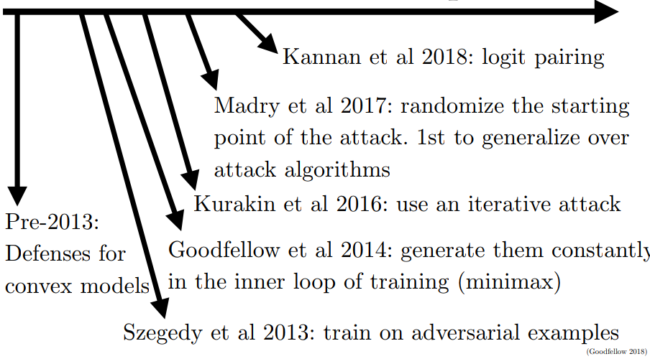
Timeline of Defences

Slide 10


Slide 11
Thank you
Questions?
Twitter: @divyam3897
Linkedin: https://www.linkedin.com/in/dmadaan3897
Github: @divyam3897

